Slide 1
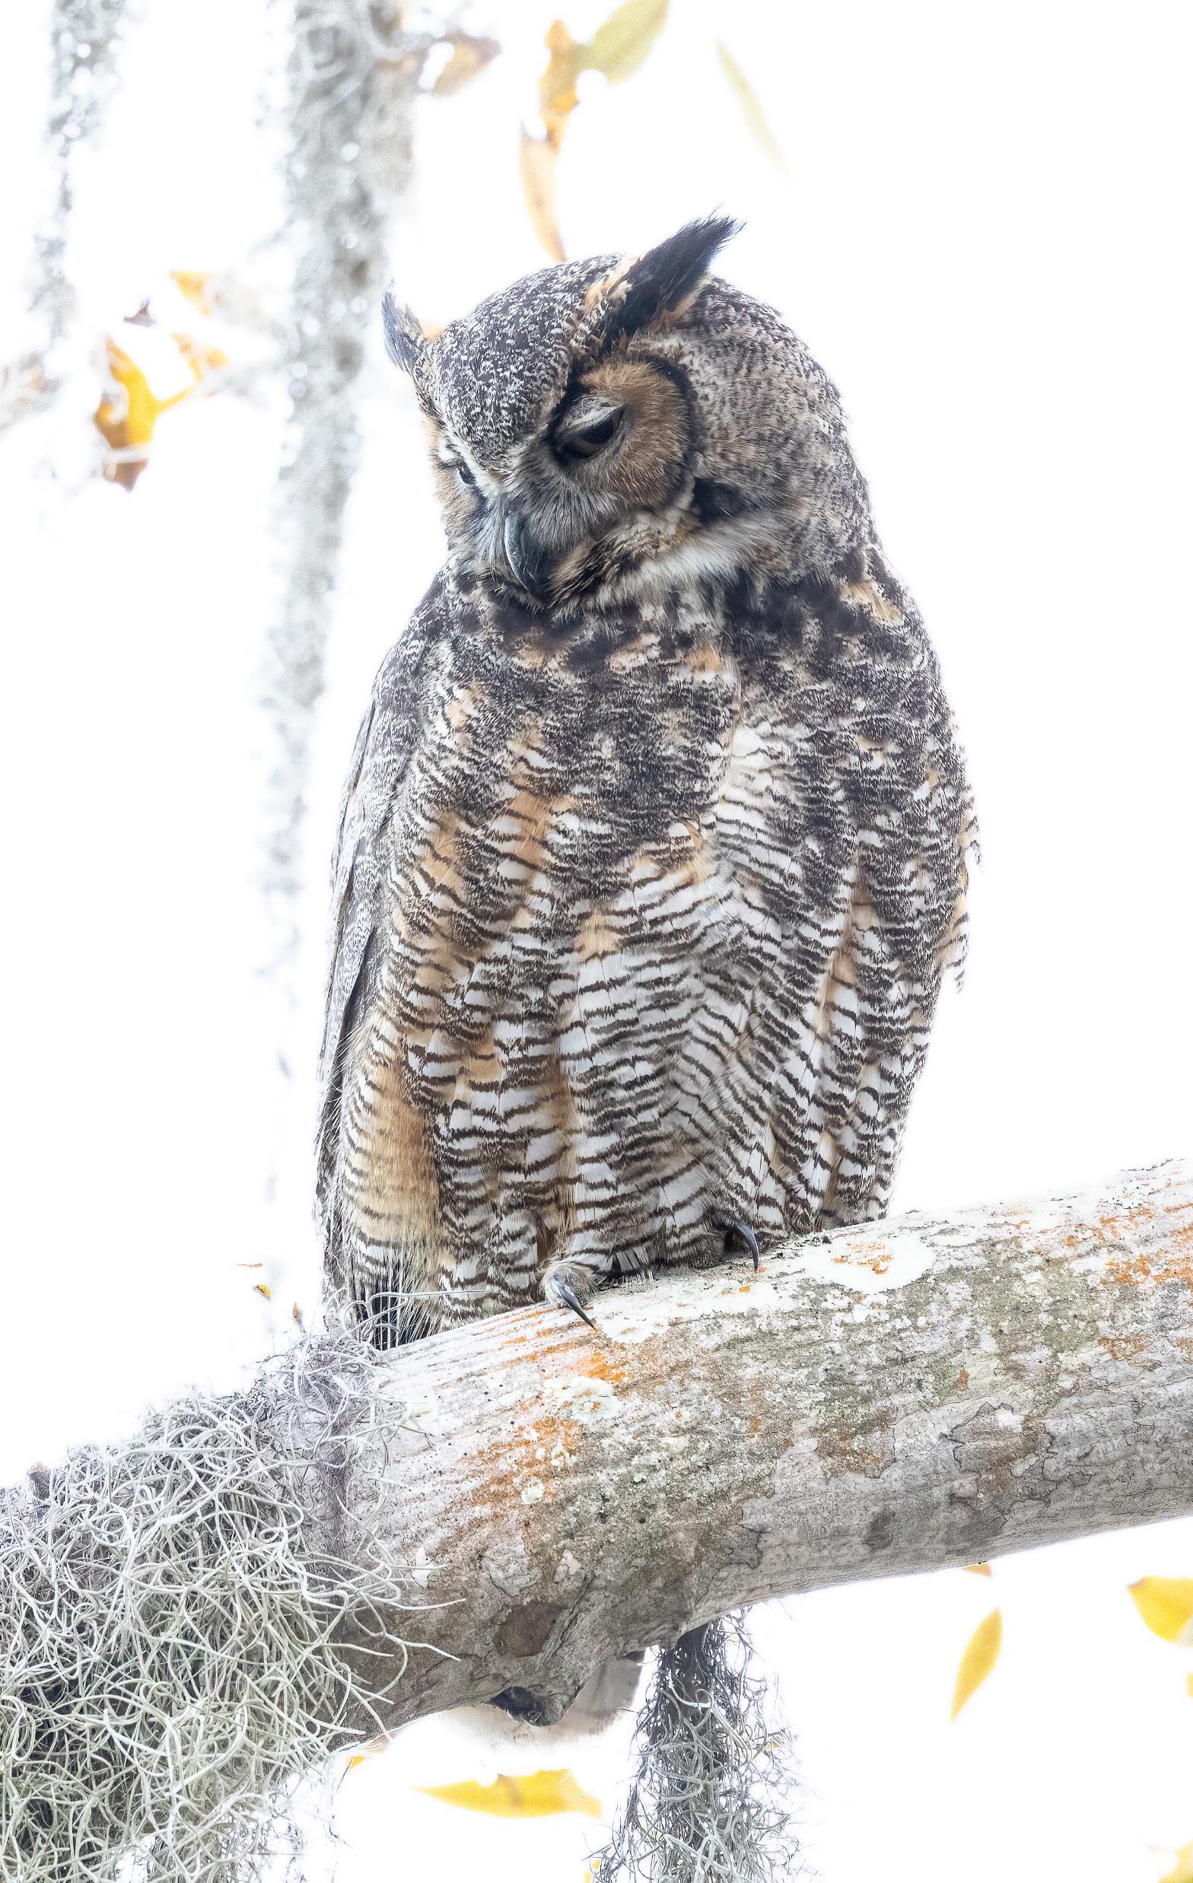
Resources
Safety Harbor Strong Owl and Nature Safety Harbor Strong Owls & Nature | Facebook
Our website www.safetyharborowls.com
Raptors are the Solution
www.raptorsarethesolution.org
Birds in Helping Hands
www.BirdsInHelping Hands.org
State of the Birds
#BringBirdsBack (3billionbirds.org)
Audubon Bird Migration Explorer
https://explorer.audubon.org/home?legend=collapse&layersPanel=expand
E-bird instructions from Cornell Labs
eBird Essentials | Bird Academy • The Cornell Lab (allaboutbirds.org)
Photo by Linda Schocken

